Slide 1
PROTECTION ON tsc TIME SYNCHRONISATION WITHIN UP SECURITY POLICY
AAdrian

Slide 2
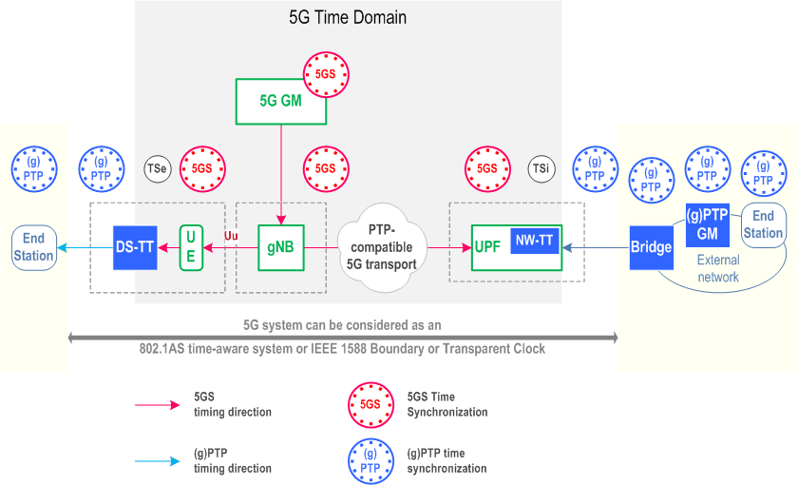
TSC - Time Sensitive Communication
TCN - Time Sensitive Network
Figure 1

Slide 3
The problem
Time synchronization is necessary for 5GS providing the TSC service. Therefore, the gPTP (Generalized Precision Time Protocol) messages are needed for the time synchronization over the 5GS, and they need to be protected.

Slide 4
Security threats
Manipulation of the clock synchronization between Master/Slave elements with the global time reference (the Grand Master, from which all the other equipments get the absolute time) .
Manipulation to the selection of communication paths and reservation of bandwidth and time slots.

Slide 5
The solution
UPF ( User plane function) forwards the gPTP message to the UE ( User Equipment ) via user plane, using the PDU ( Protocol Data Unit ) session. Only one such session is used for sending the messages, no matter how many external TSN working domains have their clock information delivered through a given UPF serving that UE.

Slide 6
The gPTP messages are received form the TSN network and transferred in 5GS in the user plane. Then, when the PDU session is established to the TSN, the SMF ( System Management Function ) provides the gNB ( NR Node B) with the UP security policy. The policy also applies to the messages transferred to the UE. Ultimately, the SMF sets the UP security policy for encryption and integrity protection to “ required “, in order to protect them.

Slide 7
REFERENCES
https://www.3gpp.org/FTP/Specs/archive/33_series/33.819/?sortby=namerev – 33819-g10 version.
ENISA Report – Security in 5G Specifications.
Figure 1: https://www.tech-invite.com/3m23/toc/tinv-3gpp-23-501_zp.html - 5.27.1.1, Content for TS 23.501 Word version: 17.2.0.

